Slide 1
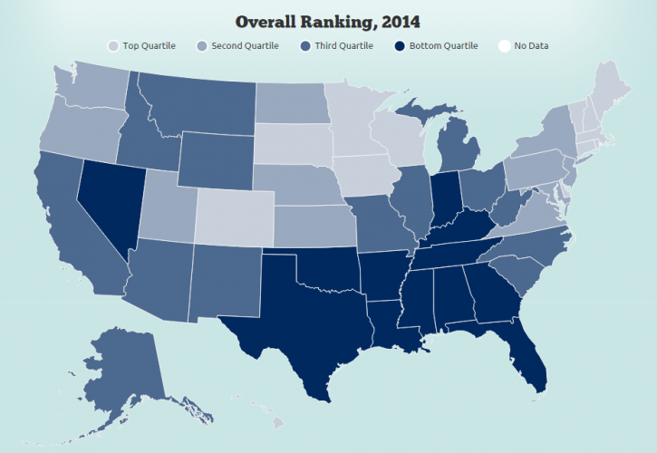
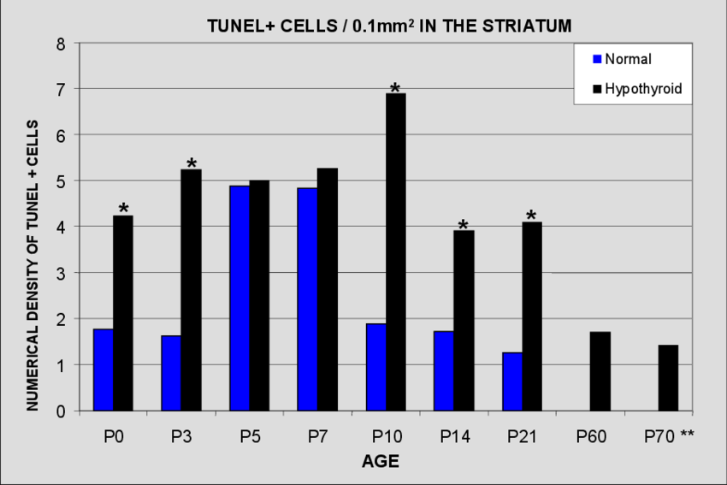
Dashboard
Correlation
Trips
COVID
1/2020
11/2020
Chart with Traffic and COVID Data by State
Chart with Traffic and COVID Data by State

Slide 2
Dashboard
1/2020
11/2020
Correlation Coefficient
Trips
COVID
Deaths
Chart with Correlation by State
Chart with Trip Data by State
Chart with COVID Cases by State
Chart with Death Totals by State
Table?
Table?
Table?
Table?

Slide 3
Text:
Explain what constitutes as a trip?
Trips are defined as movements that include a stay of longer than 10 minutes at an anonymized location away from home. Home locations are imputed on a weekly basis. A movement with multiple stays of longer than 10 minutes before returning home is counted as multiple trips. Trips capture travel by all modes of transportation. including driving, rail, transit, and air. (bts.gov)
Charts:
Bar Chart with COVID Cases and Travel by state
Values:
Ratio of people staying home vs not staying home

Slide 4
Data Sources
Bts.gov data sources:
The travel statistics are produced from an anonymized national panel of mobile device data from multiple sources. All data sources used in the creation of the metrics contain no personal information. Data analysis is conducted at the aggregate national, state, and county levels. A weighting procedure expands the sample of millions of mobile devices, so the results are representative of the entire population in a nation, state, or county. To assure confidentiality and support data quality, no data are reported for a county if it has fewer than 50 devices in the sample on any given day.

Slide 5
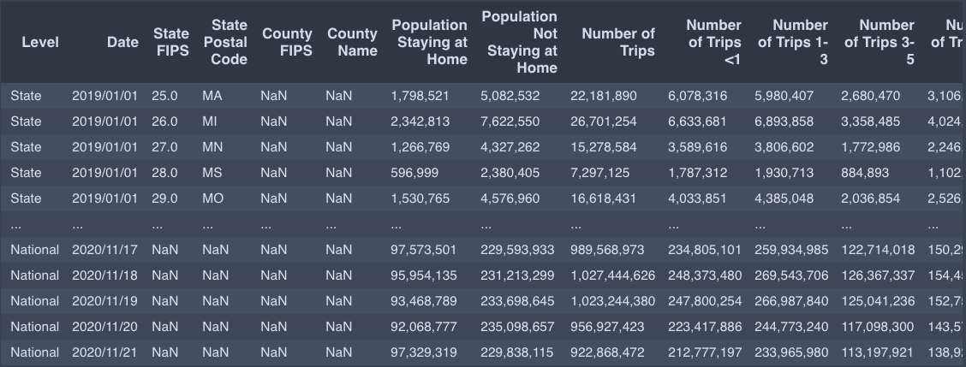

Slide 6
12/03/2020
Questions
Other Discussion Topics
How would we like to handle null values (NaN)?
I turned them to zero. DELETE THE NaN values
FYI: Some counties occur in multiple states
i.e.:
Adair County, Missouri
Adair County, Oklahoma
Adair County, Iowa
Do we really want to go down to the County Level? We could just stop at the individual states, once we have completed this and if we have time we can do the county level. YES
How would we like the States? Keep Both
State abbreviations or full state name
COVID data: full state name (i.e. Texas)
Trips data: state abbreviations (i.e. TX)
How would we like the County Names?
County Name or County Name + County
COVID data: County Name (i.e. Harris)
Trips data: County Name + County (i.e. Harris County)
Put all the data in one dataframe
Delete all the FIPS columns
All lowercase letters in the column headers
Column Names:
date
state
state_postal_code
pop_at_home
pop_not_at_home
number_trips
cases
death

Slide 7
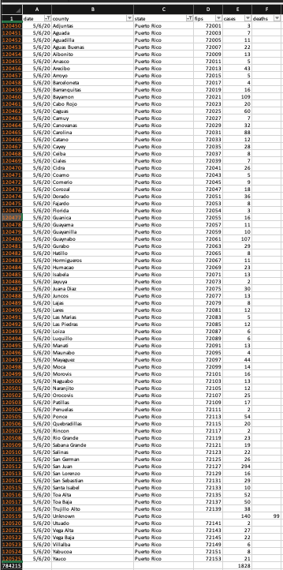
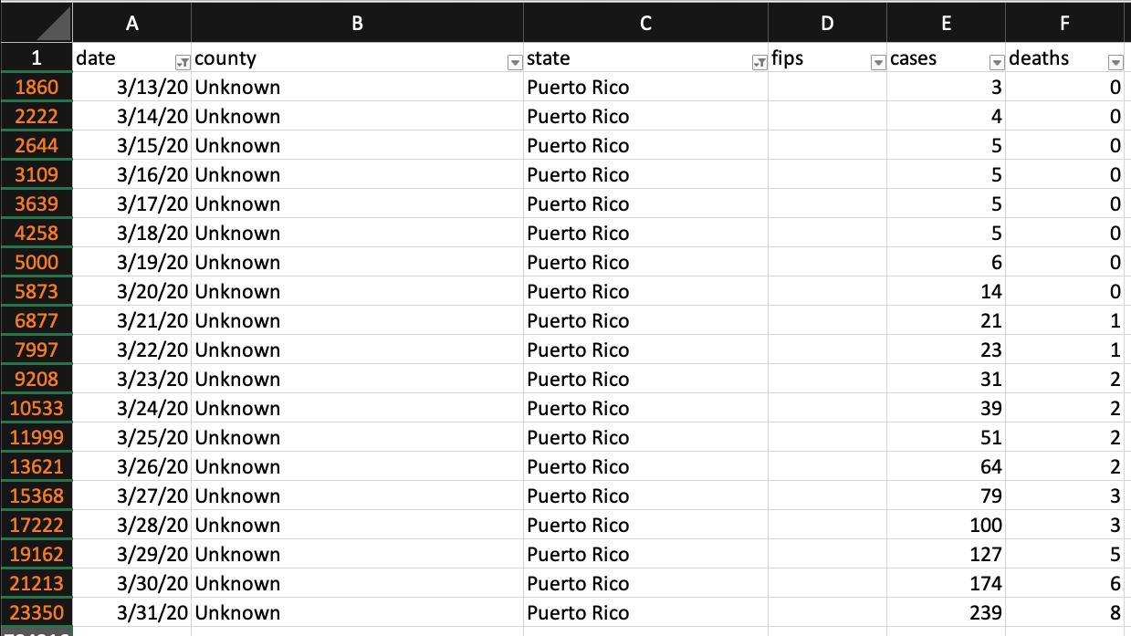
Puerto Rico COVID-19 Data
Puerto Rico has no reported deaths after May 5, 2020?
Do we want to leave the Puerto Rico data in? It seems like something is wrong with it.
Unknown County has 140 cases and 99 deaths all in the same day and no deaths in the other counties?

Slide 8
Viable architecture design
Python
JavaScript, HTML, CSS
Flask App
1. Read data from source
jsonify()
5. Expose data as JSON API
6. Read JSON API using JavaScript
7. Additional data preparation
Vincent
Sylvester
Krishna
GROUP
8. Visualize and deploy into web dashboard
2. Preliminary preprocessing or analysis
GROUP
4. Query database
Vincent
Sylvester
3. Store in persistent database
Tia
Flask route navigates user to HTML UI, which triggers JavaScript
Notes:
Data url: https://www.google.com/imgres?imgurl=https%3A%2F%2Fcdn3.iconfinder.com%2Fdata%2Ficons%2Felastic-search-line%2F128%2FElastic_Search_-_Line-05-512.png&imgrefurl=https%3A%2F%2Fwww.iconfinder.com%2Ficons%2F4665701%2Fdata_data_source_database_elastic_search_search_data_icon&tbnid=dqN_fINWpMsvQM&vet=12ahUKEwi2xK-71sjnAhVGa6wKHXXYATEQMygAegUIARCBAg..i&docid=wfCWf4QNJdT3VM&w=512&h=512&q=data%20icon&ved=2ahUKEwi2xK-71sjnAhVGa6wKHXXYATEQMygAegUIARCBAg
Database: https://static.thenounproject.com/png/9658-200.png
Api: https://static.thenounproject.com/png/410844-200.png
Data preprocessing: https://cdn4.iconfinder.com/data/icons/internet-of-things-34/66/10-512.png
Javascript: https://cdn.iconscout.com/icon/free/png-256/javascript-20-555998.png
Data visualization: https://pngimage.net/wp-content/uploads/2018/06/graph-button-png-2.png

